Slide 1
Options Basics
By Nymph

Slide 2
What are Options?
Options are a type of derivative security, which is a security that derives its value from the value of another security
Specifically, options give the right but NOT the obligation to buy/sell a particular security (or non-security asset) at an agreed upon price at (or before) an agreed upon date
This price is called the strike price, and this date is called the expiry, taking advantage of this right is called exercising the option, and the security value is derived from is called the underlying security.
An option that gives you the right to buy the underlying security is called a call option, one that gives you the right to sell it is called a put option

Slide 3
What are Options Used For?
Options are most commonly seen as insurance against a particular outcome, such as hedging the risk of a large drop in the value of your position in the underlying security. You still lose money if it goes down and the option expires worthless if it doesn’t, but the expected value of your portfolio across the distribution of both outcomes is higher (this isn’t always true, it depends on the price paid for the option).
Another reason to use options is to combine them and other positions for defined payoff structures, ensuring that you know your possible outcomes
My favorite way to use them is in expressing a view on volatility rather than direction. We’ll go over how to do this another time.

Slide 4
Types of Options
European - Most basic option, payoff of Price - Strike or Strike - Price, can only exercise on expiry
American - Most common option, same payoff as European, can exercise any time before or on expiry
Lookback Option - Exotic options where the payoff depends on “looking back” through the path the underlying security took, rather than price upon exercise
  Asian Option - The most common of these is an Asian option, which uses the average of the security’s price throughout the entire life of the option
  Others can include using the max or min price across the life of the option, but these are uncommonly used

Slide 5
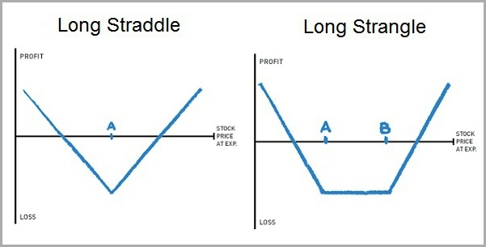
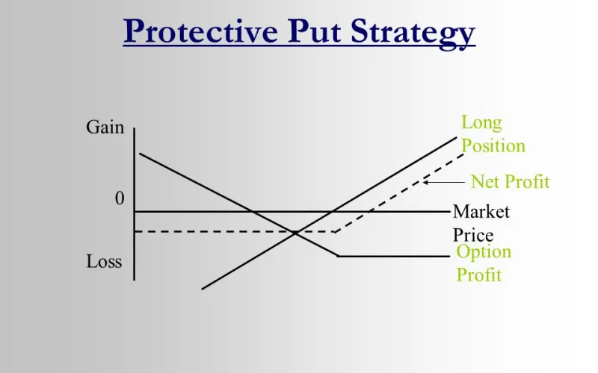
Options Spreads
Spreads are combinations of options that are used to create defined payoff structures not possible with underlying securities or single options
The spreads I use the most are straddles and strangles, which profit with volatility in either direction that outweighs the cost of the option. If the option is too expensive or you expect low volatility, you can sell the spread. We’ll talk more about hedging short spreads and other spread structures in the future.

Slide 6
Conclusion
Tbh I have no idea how long this will take to go over so I’m going to end it here and adjust the amount of content in the future if it’s too short or too long.
Next time we will cover arbitrage boundaries for single options and arbitrage relationships between different options, as well as basic pricing models for the value of an option.
Q&A TIME! I can’t promise I’ll answer everything because I don’t want to give misinformation if I don’t remember something but I’ll try.

